Slide 1

Healthcare assistant

Slide 2



Team Members
Adham Mohamed
Ahmed Samy
Ziad Shalaby

Slide 3



Team Members
Mohamed Shaban
Anton Micheal
Karen Adel

Slide 4
Story
Feel sick ?

Slide 5
Story
Feel sick ?
Need to go to a doctor ?

Slide 6
Story
Feel sick ?
Need to go to a doctor ?
Can’t find a doctor ?

Slide 7
Idea
Symptoms

Slide 8
Idea
Symptoms
AI model

Slide 9
Idea
Symptoms
AI model
Predict the disease

Slide 10
Steps
1-Data Gathering

Slide 11
Steps
1-Data Gathering
2-Data preprocessing

Slide 12
Steps
3-Model training

Slide 13
Steps
3-Model training
4-Deployment

Slide 14
Data Gathering

Slide 15
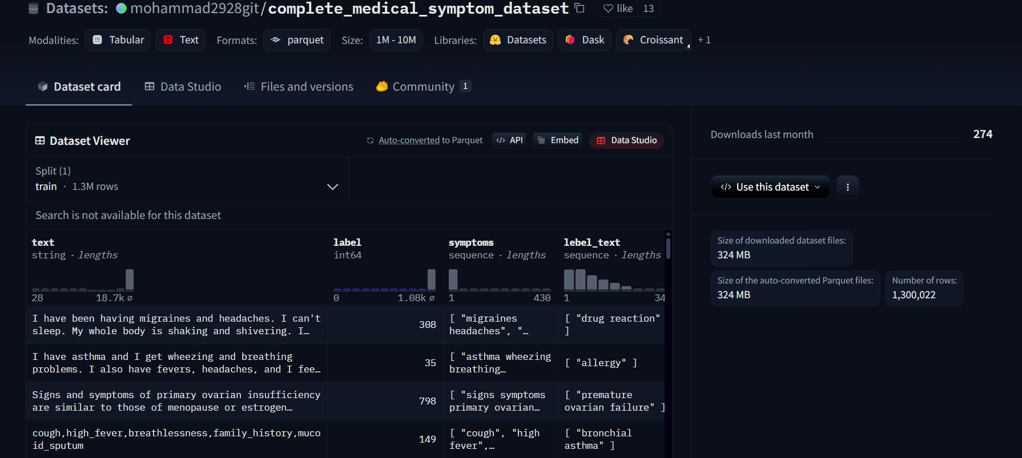
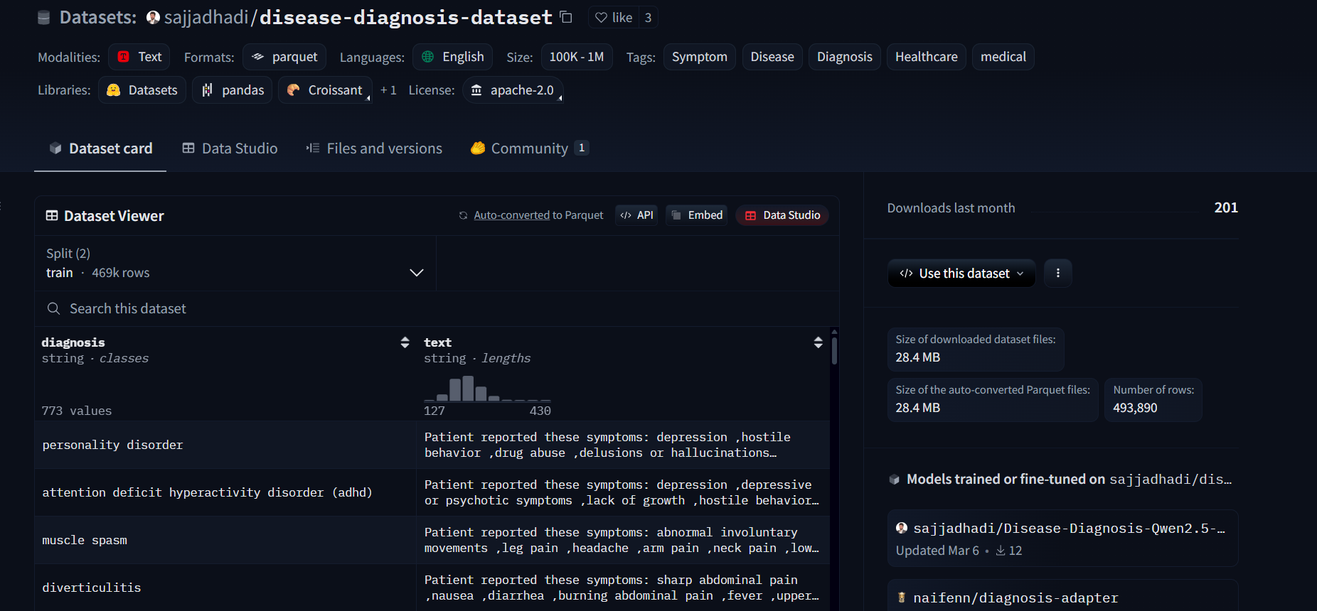
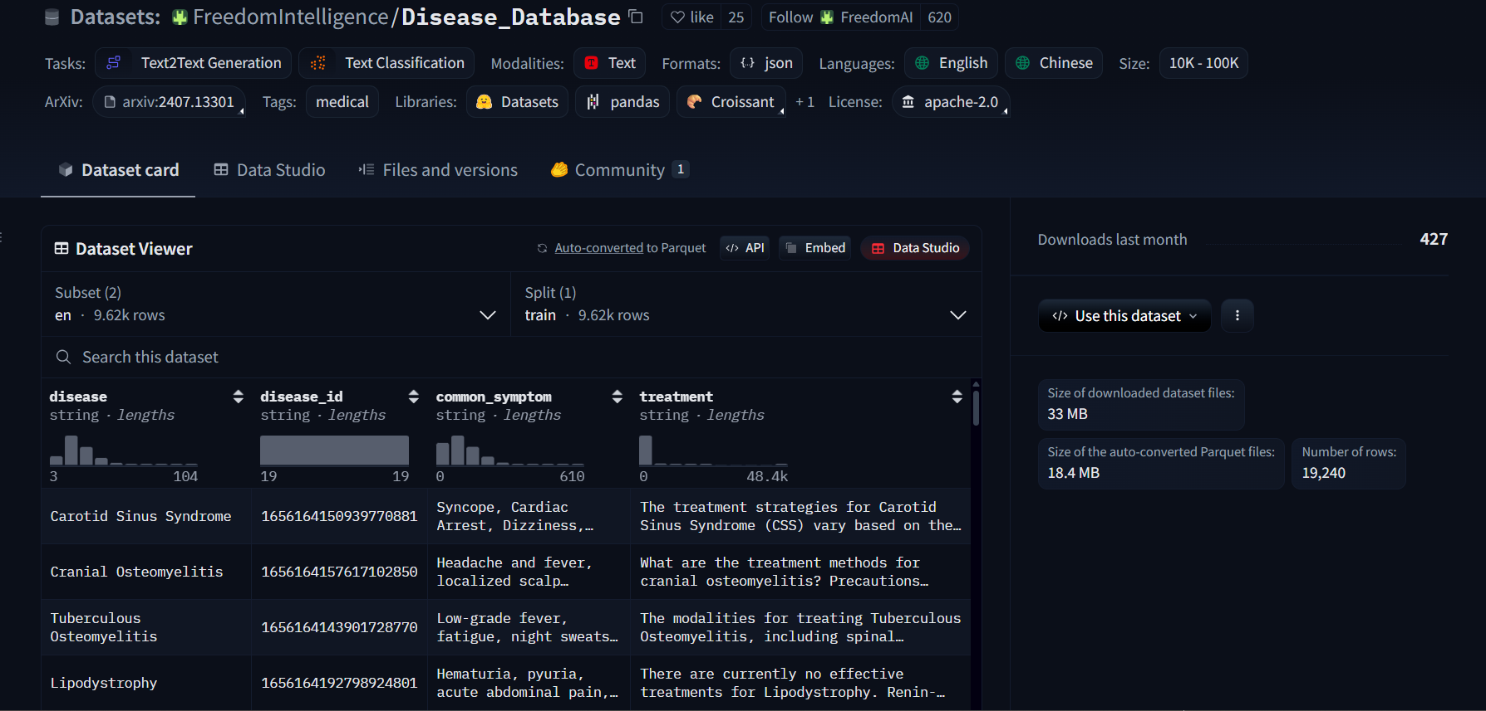
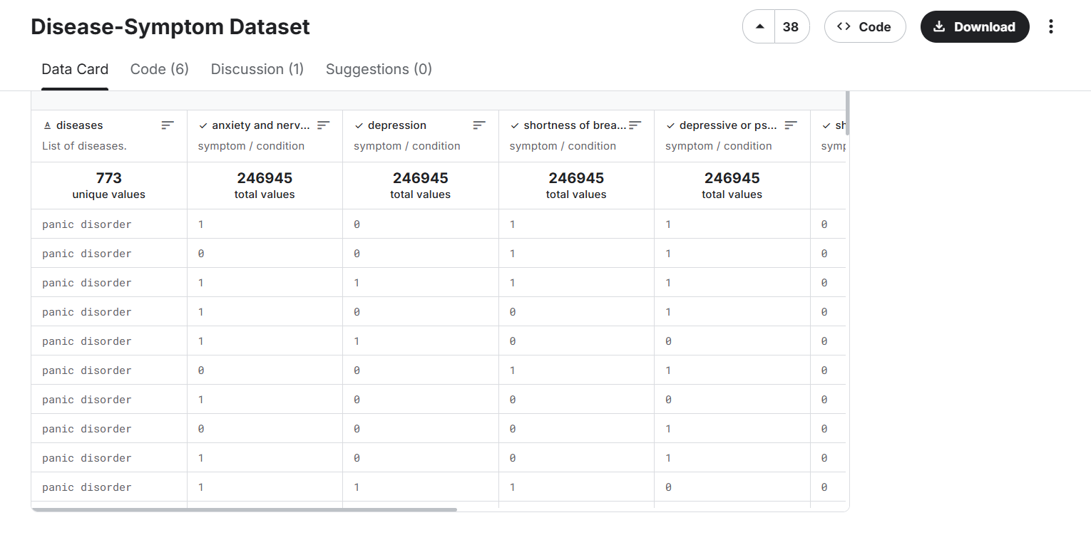
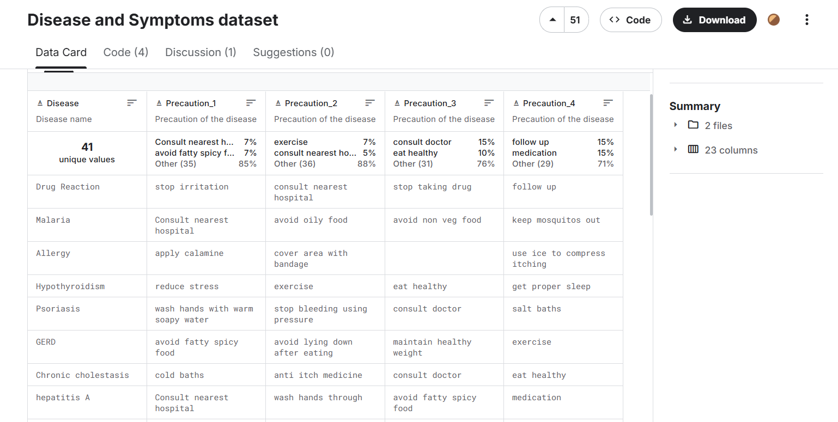
Data Gathering

Slide 16
Data Gathering

Slide 17
Data Gathering

Slide 18
Data Gathering

Slide 19
Data Gathering

Slide 20
Steps
Data Gathering tasks
Three datasets were selected

Slide 21
Steps
Data Gathering tasks
Three datasets were selected
Two members for one dataset

Slide 22
Steps
Data Gathering tasks
Ziad Shalaby & Adham Mohamed

Slide 23
Steps
Data Gathering tasks
Ziad Shalaby & Adham Mohamed
Ahmed Samy & Mohamed Shaban

Slide 24
Steps
Data Gathering tasks
Ziad Shalaby & Adham Mohamed
Ahmed Samy & Mohamed Shaban
Anton Micheal & Karen Adel

Slide 25
Steps
Data Gathering challenges
Distribution of the data

Slide 26
Steps
Data Gathering challenges
Distribution of the data
The data is extremely huge

Slide 27
Steps
Data Gathering challenges
Distribution of the data
The data is extremely huge
Using the data locally

Slide 28
Data preprocessing

Slide 29
Steps
Data preprocessing
Stopwords removing

Slide 30
Steps
Data preprocessing
Stopwords removing
Text cleaning

Slide 31
Steps
Data preprocessing
Stopwords removing
Text cleaning
Text lemmatizing

Slide 32
Steps
Data preprocessing
Stopwords removing
Text cleaning
Text lemmatizing
Label encoder

Slide 33
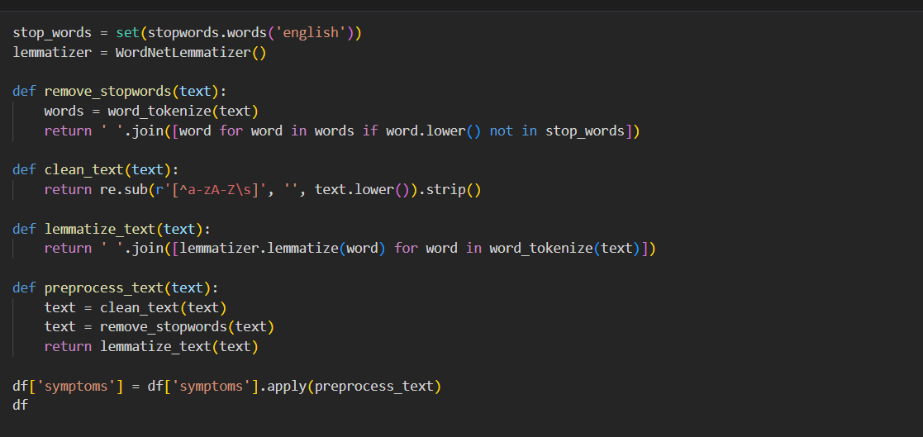
Data preprocessing

Slide 34
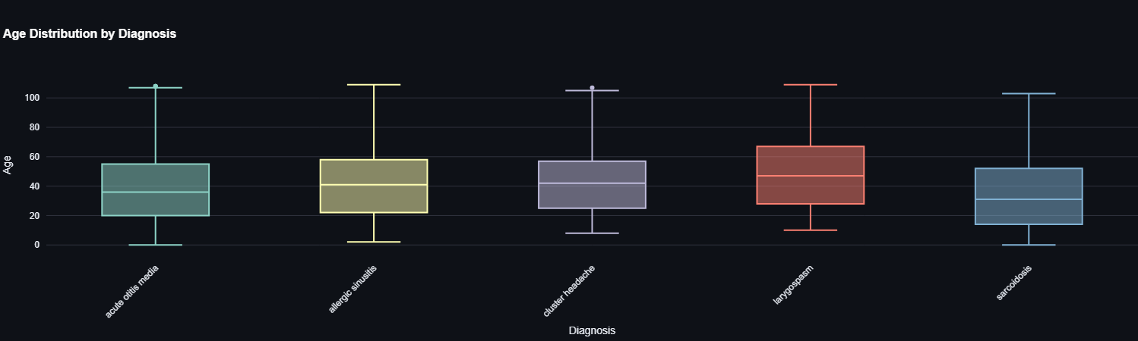
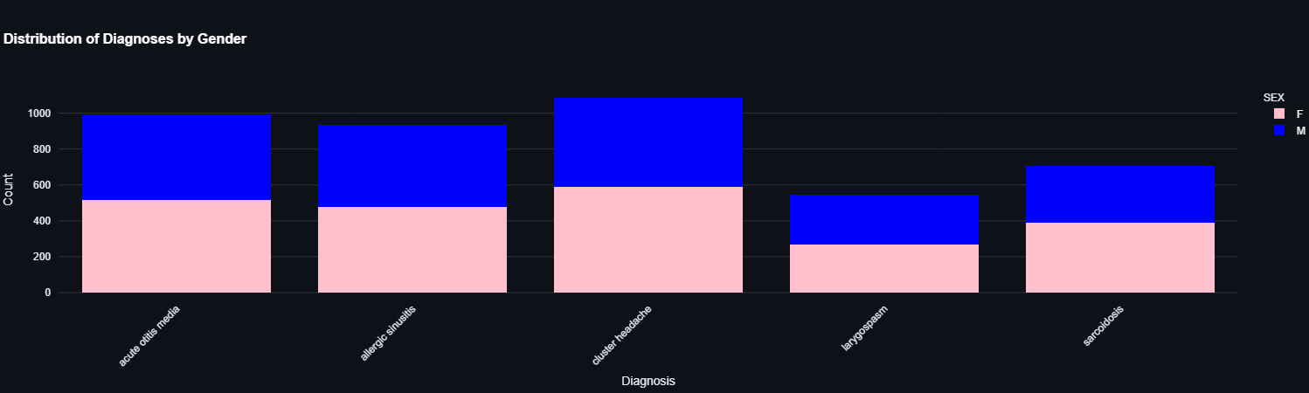
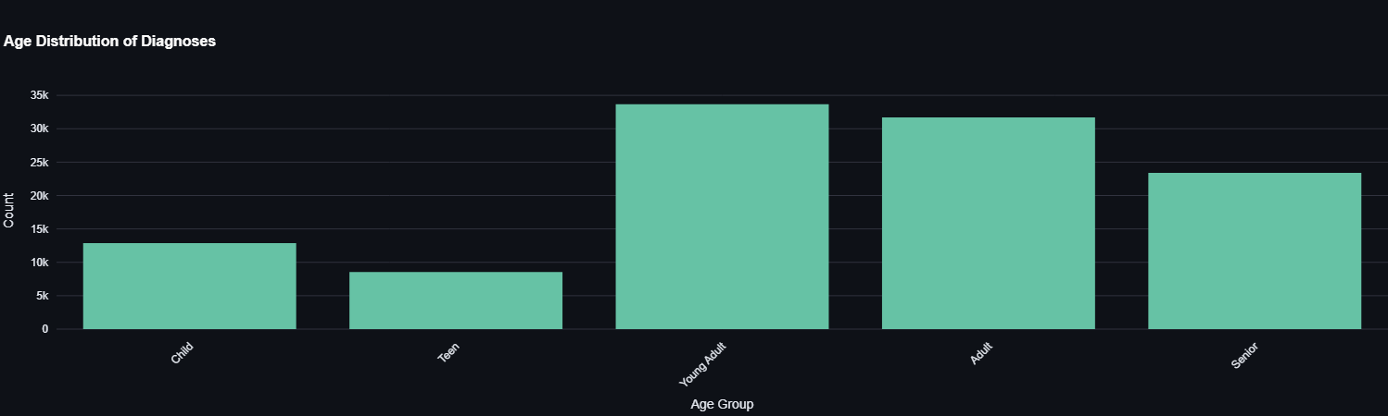
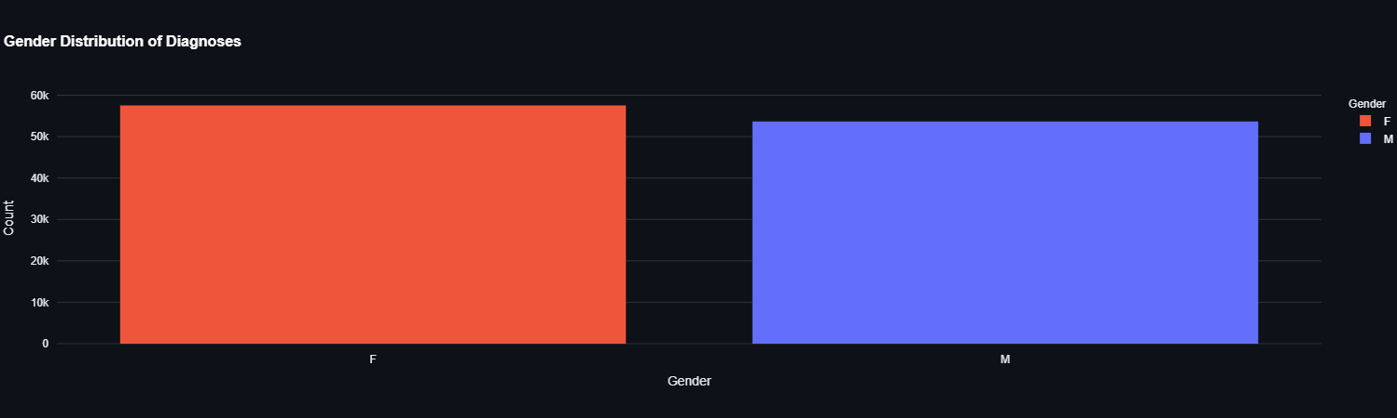
Insights from data

Slide 35
Insights from data

Slide 36
Steps
Data preprocessing
challenges
Handling noisy text

Slide 37
Steps
Data preprocessing
challenges
Removing irrelevant characters
Handling noisy text

Slide 38
Steps
Data preprocessing
challenges
Managing inconsistent formatting

Slide 39
Steps
Data preprocessing
challenges
Managing inconsistent formatting
Disease in symptoms column

Slide 40
AI model

Slide 41
Steps
AI model
Machine learning models

Slide 42
Steps
AI model
Machine learning models
Deep learning models

Slide 43
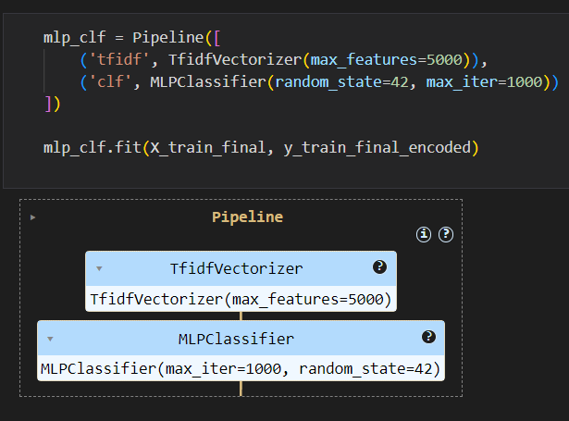
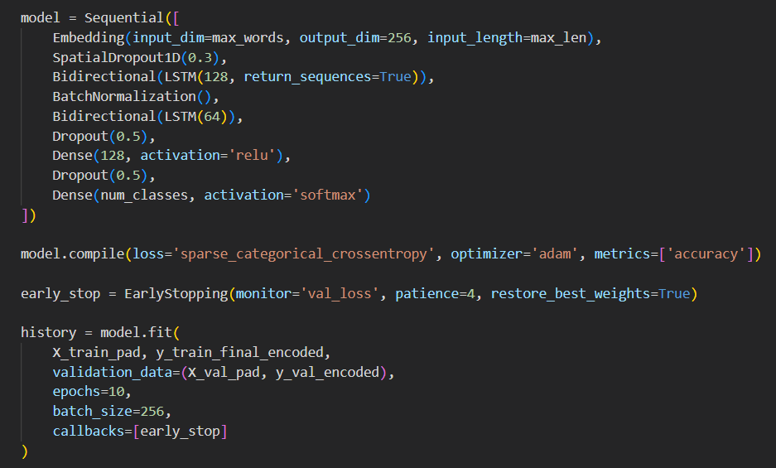
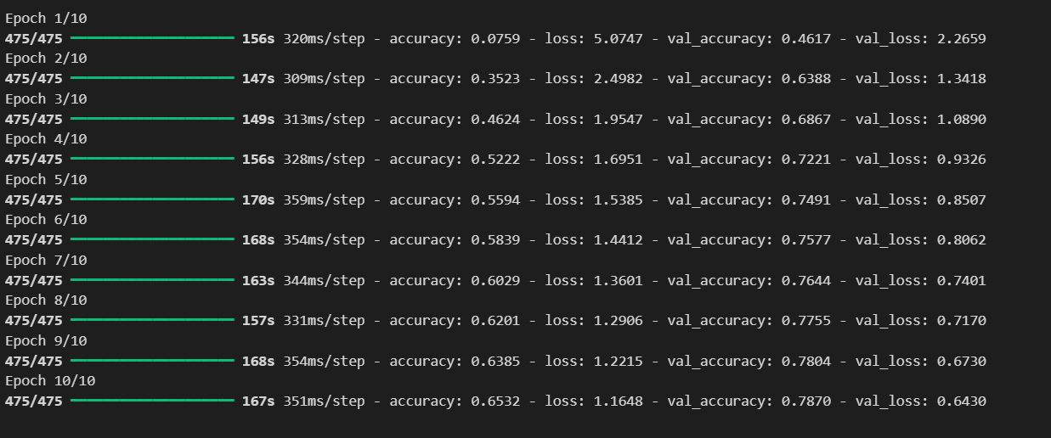
Building the models

Slide 44
Building the models

Slide 45
Building the models

Slide 46
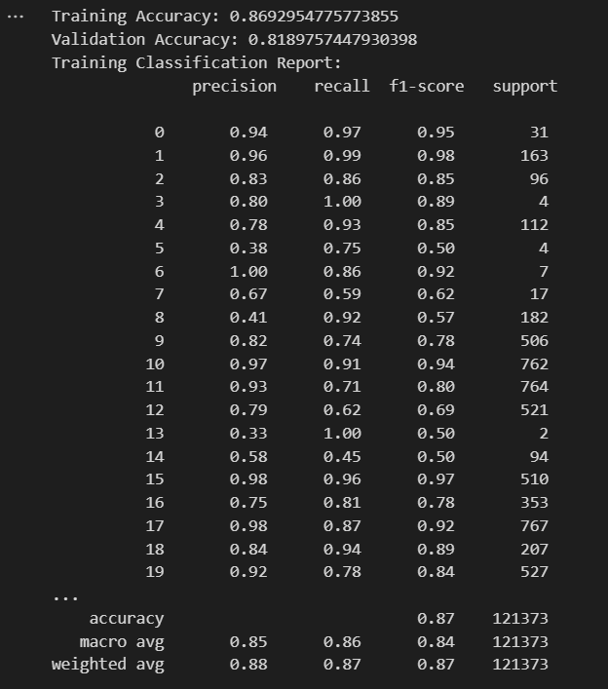
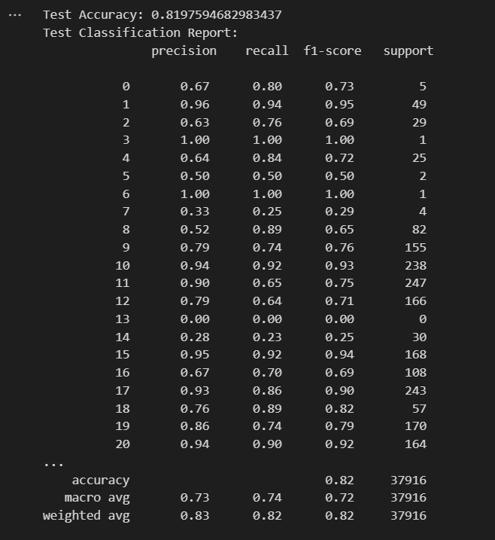
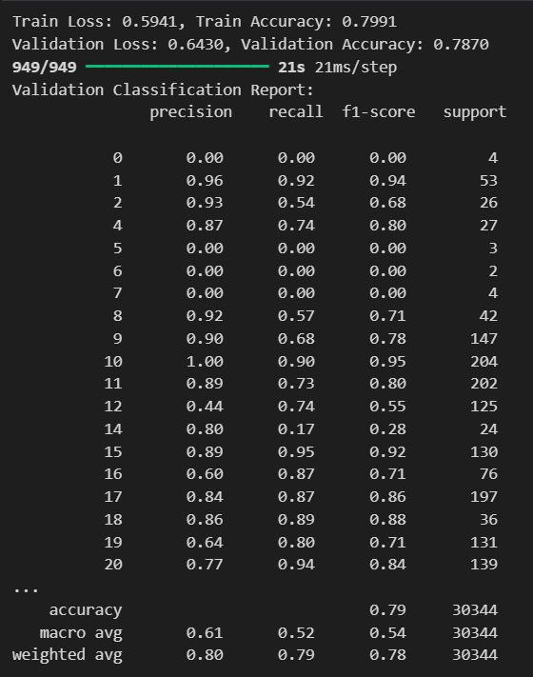
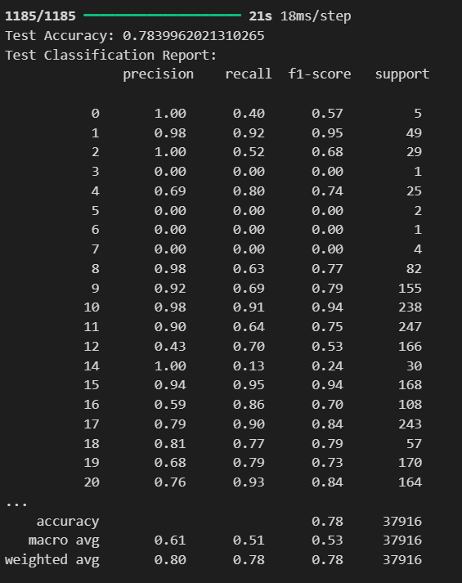
Testing the models

Slide 47
Testing the models

Slide 48
Steps
AI model challenges
Choosing right algorithm

Slide 49
Steps
AI model challenges
Choosing right algorithm
Overfitting

Slide 50
Steps
Final AI model
Multiple AI models

Slide 51
Steps
Final AI model
Multiple AI models
Act as ensemble model

Slide 52
Deployment

Slide 53
Steps
Deployment
Streamlit

Slide 54
Steps
Deployment
Streamlit
Our models

Slide 55
Steps
Deployment
Streamlit
Our models
API

Slide 56
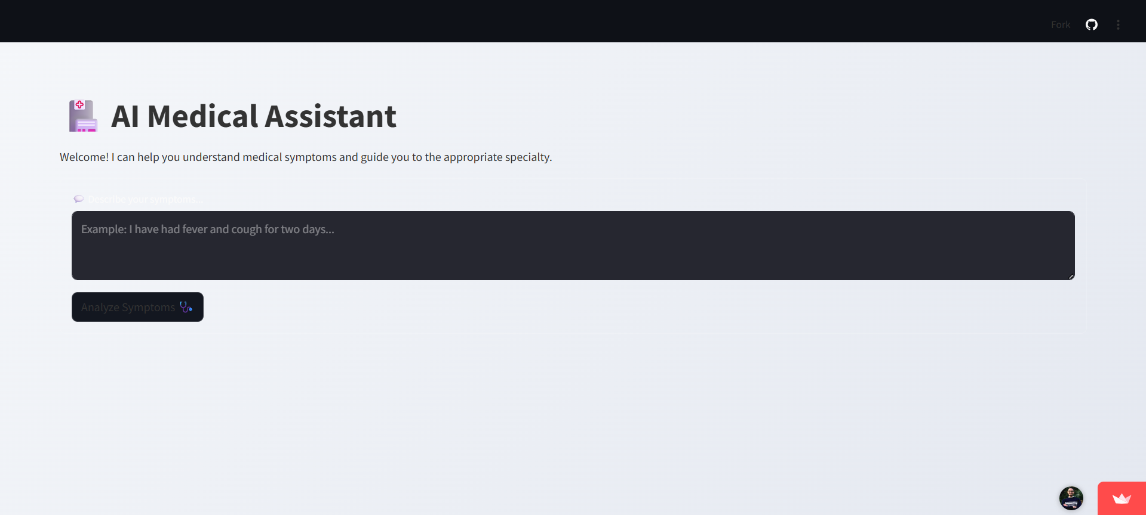

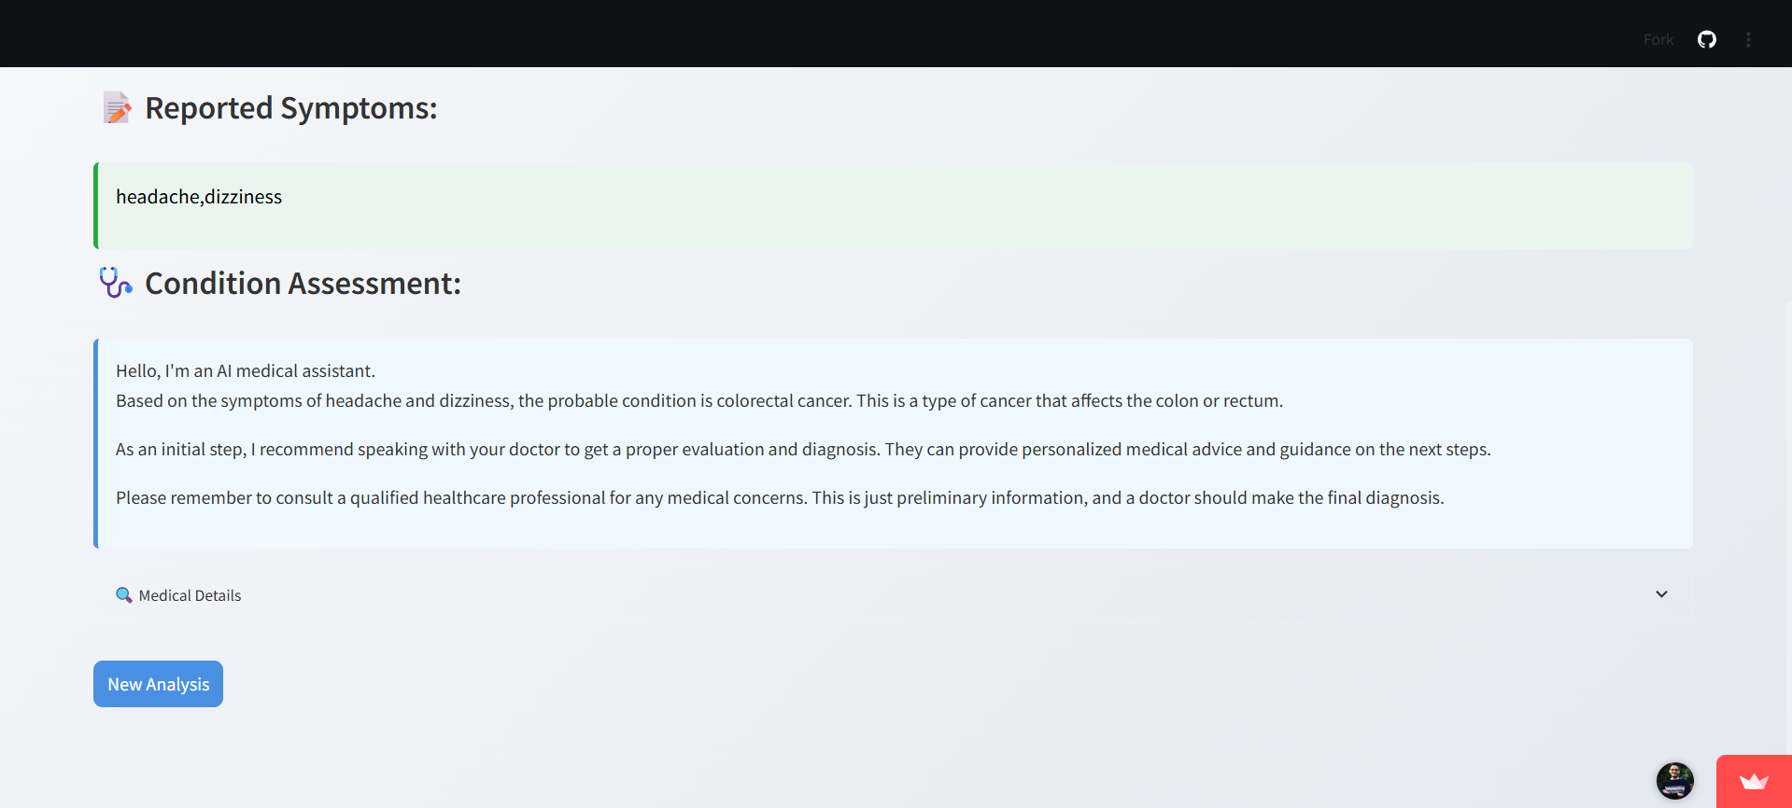
User interface (Old version)

Slide 57
Let’s try (Old version)

Slide 58
The answer (Old version)

Slide 59
Steps
Old version problems
Not enough data

Slide 60
Steps
Old version problems
Not enough data
Model overfit

Slide 61
Steps
Old version problems
Not enough data
Model overfit
Wrong Answers

Slide 62
Steps
Final application strategy
Six questions to know patient symptoms

Slide 63
Steps
Final application strategy
Six questions to know patient symptoms
All models predict the disease

Slide 64
Steps
Final application strategy
The most voted answer is taken

Slide 65
Steps
Final application strategy
Return the answer from API and patient talk
The most voted answer is taken

Slide 66
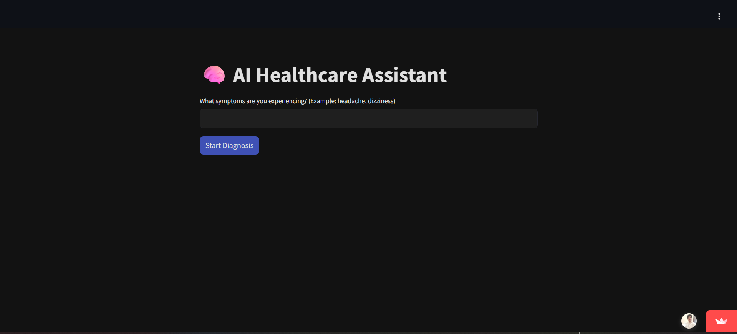
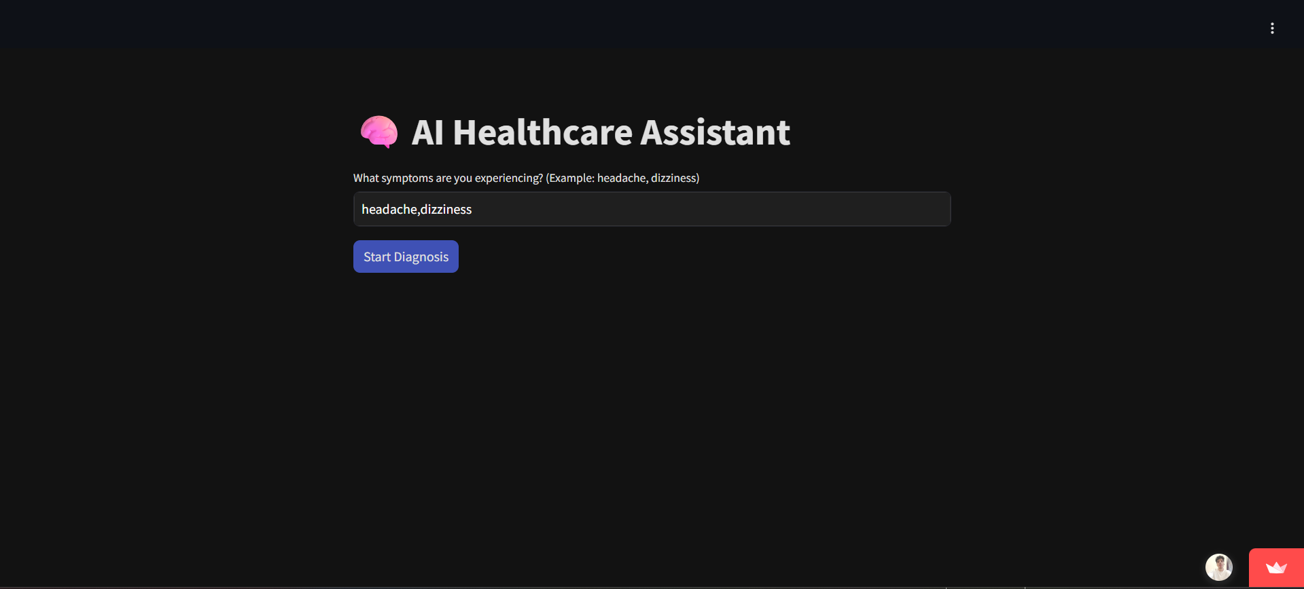
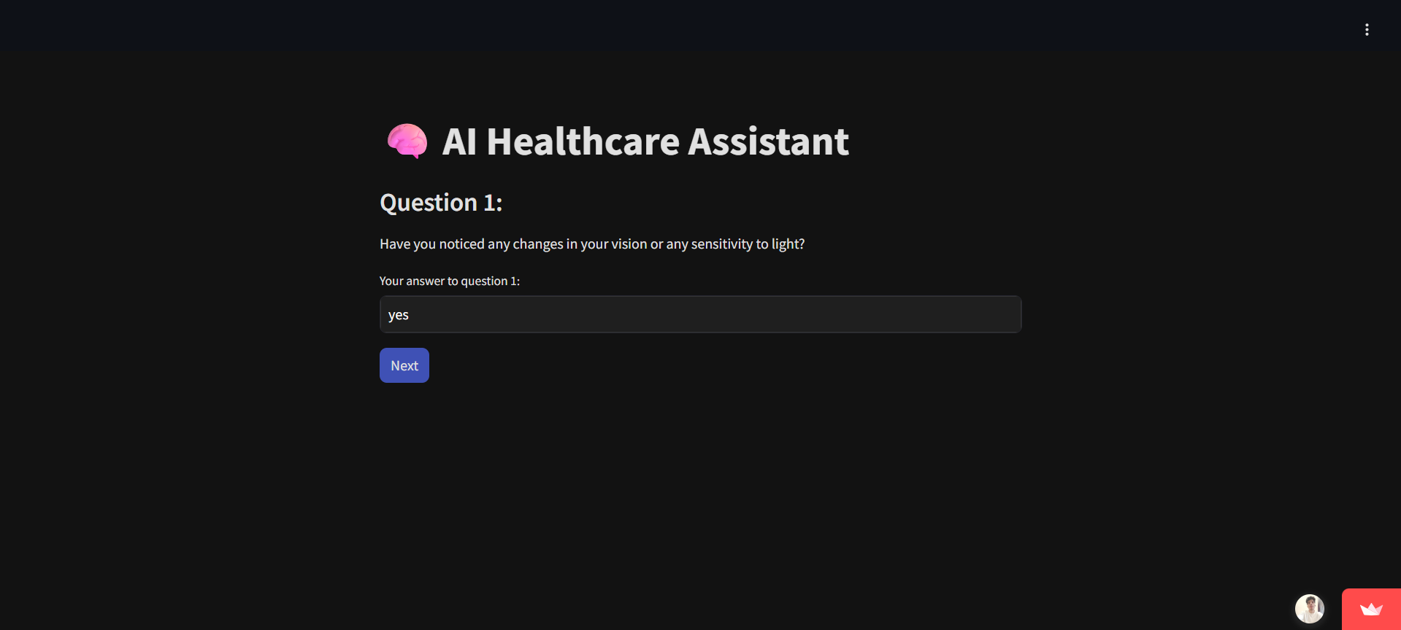
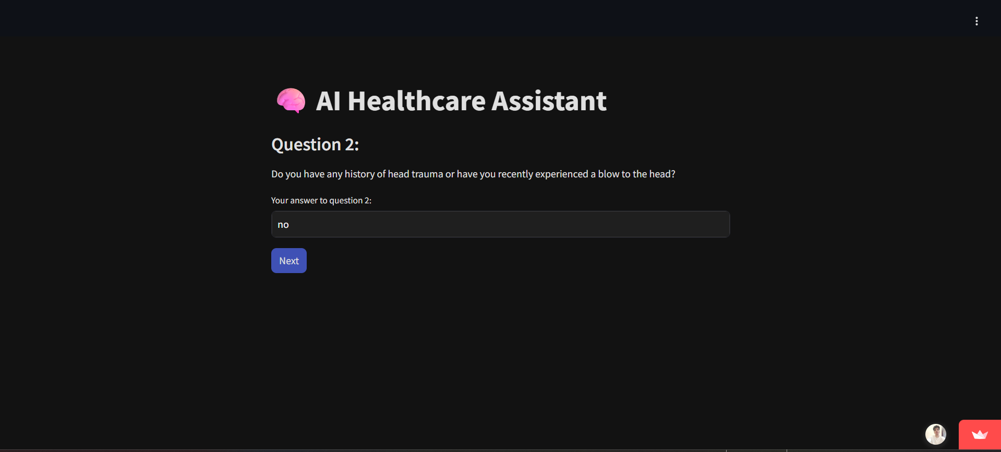




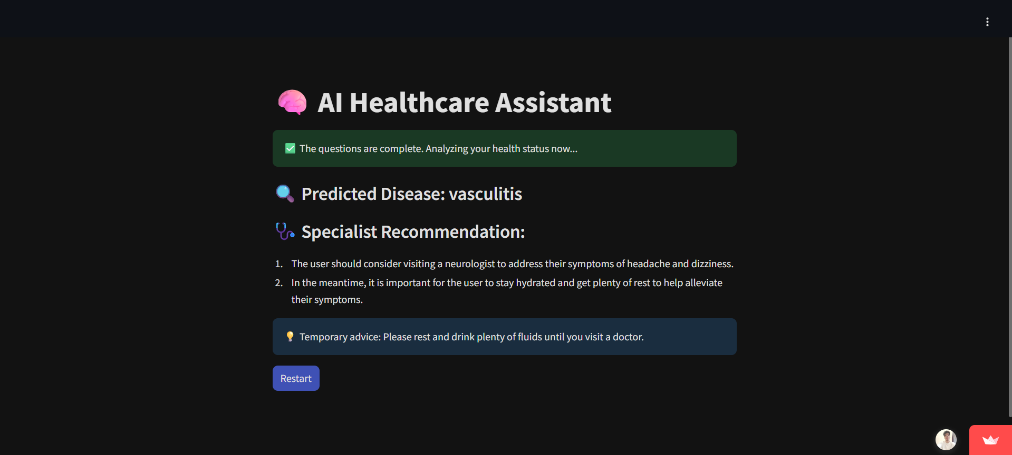
User interface

Slide 67
Let’s try

Slide 68
First question

Slide 69
Second question

Slide 70
Third question

Slide 71
Fourth question

Slide 72
Fifth question

Slide 73
Sixth question

Slide 74
The answer

Slide 75
Q&A

Slide 76
THANKS

